Slide 1
CS 31006: Computer Networks

Slide 2
Who’s Who
Course Instructor: Sandip Chakraborty
http://cse.iitkgp.ac.in/~sandipc/
sandipc@cse.iitkgp.ernet.in
Office: CSE-311, CSE Main Building
Office Hours: Tuesday (5:00 – 6:00 pm), others by appointment through email
Teaching Assistant: Satadal Sengupta
satadal.sengupta@iitkgp.ac.in
Office: CNeRG Lab, CSE Main Building
Meeting through email appointments

Slide 3
Objectives of the Course
Understand how two computers in the Internet talk to each other
Go through the basic functionalities of the computer networks
Learn how to program the network
Learn the future of the computer network – Do we need any further changes in the design?
Functionalities
Protocols
Network Architecture

Slide 4
So, What is Network Architecture?
A way to visualize how two remote computers talk to each other
Network Protocol Stack

Slide 5
So, What is Network Architecture?

Slide 6
So, What is Network Architecture?
Requirement: Convert digital data to analog signal and vice versa
Physical

Slide 7
So, What is Network Architecture?

Slide 8
So, What is Network Architecture?
L2 Switch
Data Link
Requirement: Ensure proper scheduling in media access
Physical

Slide 9
So, What is Network Architecture?

Slide 10
So, What is Network Architecture?
L3 Switch or Routers
Network
Data Link
Physical
Requirement: Find out a suitable path to forward data

Slide 11
So, What is Network Architecture?

Slide 12
So, What is Network Architecture?
Transport
Network
Data Link
Physical
Requirement: End to end traffic control in the network

Slide 13
So, What is Network Architecture?
Application
Transport
Network Protocol Stack
Network
Data Link
Physical

Slide 14
Data Transfer between Two Remote Machines
Source
Destination

Slide 15
Data Transfer between Two Remote Machines
Application
Application
Transport
Transport
Network
Network
Network
Data Link
Data Link
Data Link
Data Link
Data Link
Physical
Physical
Physical
Physical
Physical

Slide 16
Protocols at Different Layers
Application
HTTP, FTP, SMTP
Transport
TCP, UDP, RTP
Network
IPv4, IPv6, MPLS
Data Link
Ethernet, WiFi, Bluetooth, UMTS, LTE
Physical

Slide 17
Network Management and Control – Cross Layer Protocols
Application
HTTP, FTP, SMTP
DNS
Transport
TCP, UDP, RTP
SNMP
Network
IPv4, IPv6, MPLS
ARP, DHCP
Data Link
Ethernet, WiFi, Bluetooth, UMTS, LTE
Physical

Slide 18
Two Ways to Learn Computer Networks
Application
Application
Transport
Transport
Network
Network
Data Link
Data Link
Physical
Physical

Slide 19
Books to Follow …
Application
Transport
Network
Data Link
Physical

Slide 20
Books to Follow …
Application
Transport
Network
Data Link
Physical

Slide 21
Books to Follow (Online Books)…
Application
Transport
Network
Data Link
Physical
http://www.redbooks.ibm.com/abstracts/gg243376.html
http://www.tcpipguide.com/

Slide 22
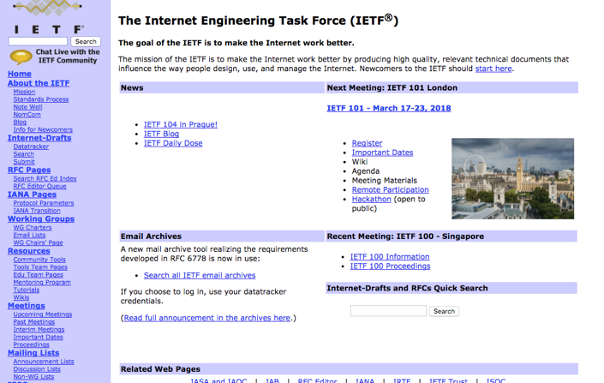
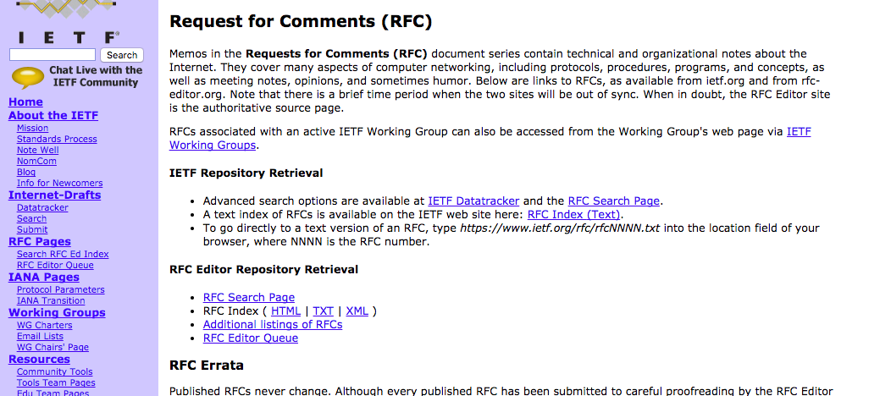
Internet Resources

Slide 23
Course Evaluations
Two class tests
Average: 20%
Mid semester Examination: 30%
End-semester Examination: 50%

Slide 24
Other Course Related Informations
Course Website: http://cse.iitkgp.ac.in/~sandipc/Courses/CS_31006_Spring_2018.html
All course materials will be posted in the website
We’ll set up a Piazza group – please use the group for any discussions
Attendance: Institute policy will be followed – deregistration for low attendance
Make the class live – no question is a stupid question !!!

Slide 25
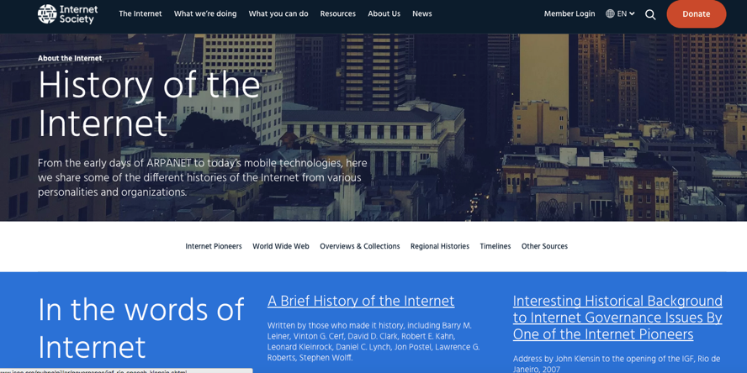
History of Computer Networks
https://www.youtube.com/watch?v=9hIQjrMHTv4
https://www.internetsociety.org/internet/history-internet

